Slide 1

Efficient processing of ATLAS events analysis in platforms with accelerator devices
University of Minho
Department of Informatics
André Pereira
Prof. Alberto Proença (Advisor)
Prof. António Onofre (Co-Advisor)
Notes:
Bom dia, vou falar do processamento eficiente de análise de eventos do projecto ATLAS em plataformas com aceleradores

Slide 2
Overview
Motivation
Structure of ttH_dilep
Analysis of critical regions
Improving efficiency through parallelism
On shared memory homogeneous systems
On heterogeneous systems with a GPU accelerator
On heterogeneous systems with a MIC accelerator
Efficient data & workload scheduling

Slide 3
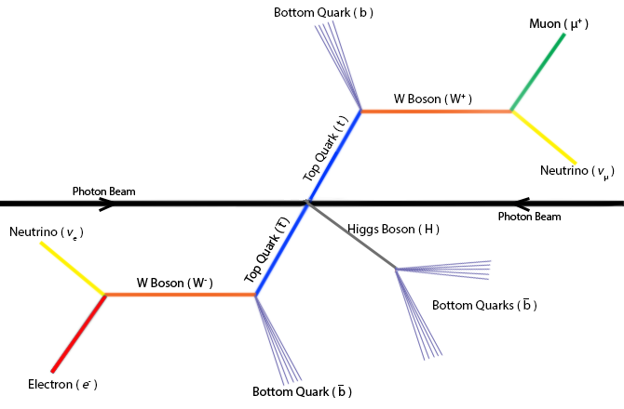
Motivation
The target model for an event
Reconstruction of the Top Quarks (t&ī) system with Higgs boson
the analysis and reconstruction code => ttH_dilep
Goal: to develop efficient ttH_dilep code
Notes:
Representação esquemática actualmente aceite do sistema ttbar e do decaímento do bosão de Higgs resultante do evento
Objectivo: reconstruir os t t e os bosoes de Higgs utiliando código eficiente
Desafios:
- As características das partículas finais são gravadas pelo detector. Estes detectores tem uma resoluçao experimental que introduz um erro de 2% aos dados medidos
- Neutrinos não são detectados mas podem ser reconstruídos por um processo denominado de reconstrução cinemática
- Software de análise perceber quais jactos pertencem ao ttbar ou à reconstrução de Higgs

Slide 4
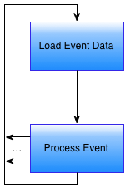
Structure of ttH_dilep (1)
For each event in the input file

Slide 5
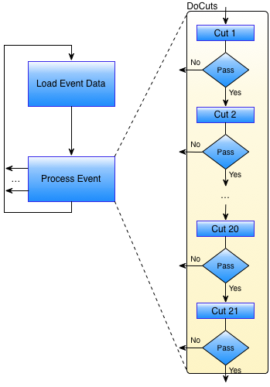
Structure of ttH_dilep (2)
All cuts except #20
Simple filters
Filters cut events:
Duplicated
With fewer than 2 isolated leptons with opposite signs
With fewer than 2 jets
With particle masses outside a specific range
…

Slide 6
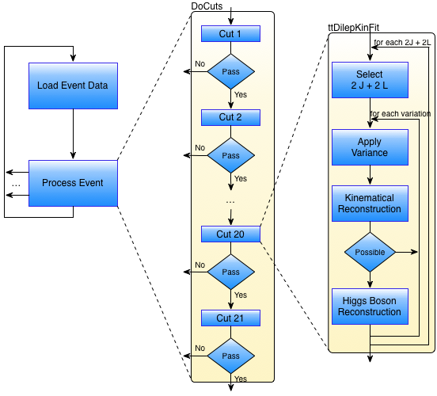
Structure of ttH_dilep (3)
Cut #20
Complex filter: ttDilepKinFit aka KinFit

Slide 7
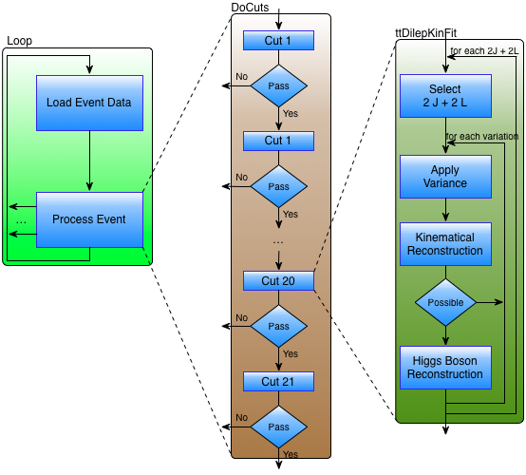
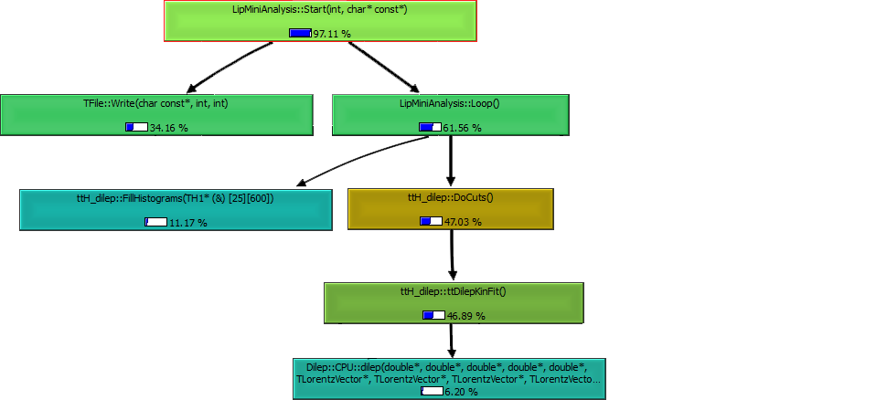
Profiling ttH_dilep (1)
Callgraph
of the original ttH_dilep
with no variations

Slide 8
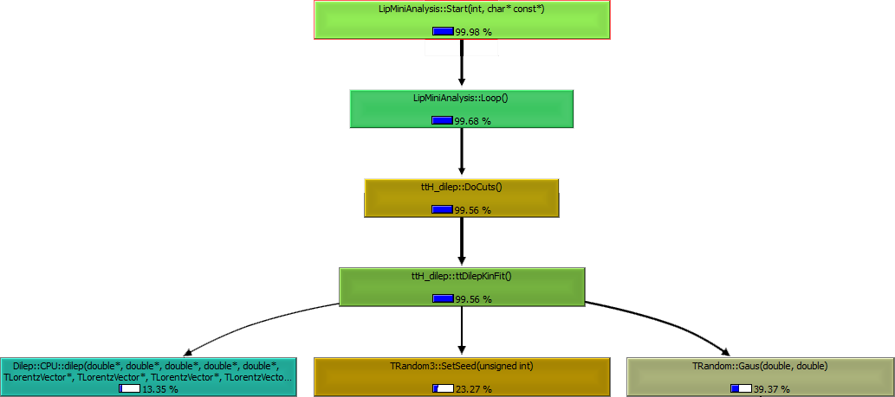
Profiling ttH_dilep (2)
Callgraph
of the original ttH_dilep
for 256 variations
per combination

Slide 9
Critical regions in ttH_dilep
# variations per event

Slide 10
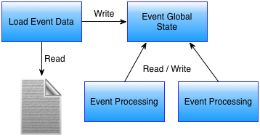
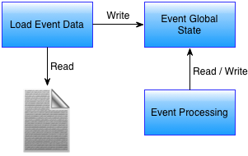
Improving efficiency with parallelism…
Sequential
Parallel
...

Slide 11
… no way with single global state!
Sequential
Parallel
...
Text missing here...

Slide 12
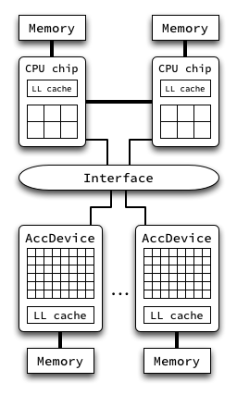
Lab target hardware systems
4-core: Intel Xeon X (Core): cluster nodes 401
6-core: Intel Xeon X5650 (Nehalem): c.n. 601
8-core: Intel Xeon E5-2670 (Sandy Bridge): c.n. 711 – best efficiency
12-core: AMD Opteron 6174 (Magny-Cours): c.n. 511
⬆ Dual socket homogeneous system, shared memory, no accelerators
⬇ Heterogeneous system, distributed memory with accelerators
GPU
NVidia Tesla C2050 (Fermi), 14 SM: cluster nodes 511
NVidia Tesla K20x (Kepler), 16 SMX: c.n 711
Intel MIC
Xeon Phi (Knights Corner), 60-core: c.n 711

Slide 13
Testbed environment (software)
Operative System
CentOS 5.3: cluster nodes 401, 511, 601
CentOS 6.4: cluster nodes 711
ROOT v5.34/04
Compilers
Gcc 4.4.7: cluster nodes 711
Gcc 4.6.3: cluster nodes 401, 511, 601
Nvcc (CUDA 5.0)
Icc 13.1
Input data file with 5738 events
1867 reach the cut #20

Slide 14
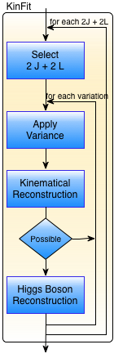
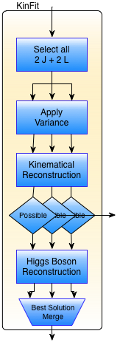
Alternative1a: parallelize KinFit, shared memory, no h/w accelerators
Sequential
Parallel
Selects all sets of 2 jets & 2 leptons, and builds a new data structure for each set
In parallel:
applies a fixed tolerance (variation) to each measure
performs a kinematical reconstruction
reconstructs the Higgs Boson
selects the best solution (reduction)
The new data structure:
all data are replicated; or
common data share a pointer

Slide 15
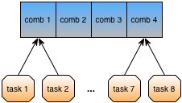
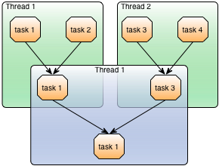
Alternative 1a: parallelization methodology
Parallel tasks use a common data structure
One task per variation per combination
All computations are applied to a local copy of the combination
Only the best solution is needed
Parallel reduction among the tasks to find the best solution
For N tasks, with comparison time C, the cost is reduced from N*C to log₂(N)*C

Slide 16
Performance analysis (1)
System: c.n. 711
# of variations per event

Slide 17
Performance analysis (2)

Slide 18
Performance analysis (3)

Slide 19
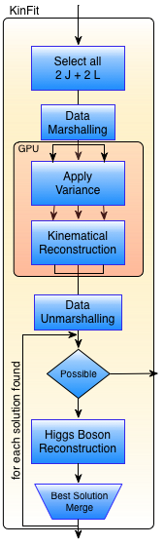
Alternative 1b: parallelize KinFit, with GPU accelerator (distributed memory)
Parallel, no accelerator
Parallel: 1-core + GPU
Data marshalling:
Transform ROOT (and application classes) in arrays to transfer to the GPU
In the GPU:
Apply the variance on the inputs
Perform the kinematical reconstruction
Data unmarshalling:
Transform the data on the arrays in the original classes with the updated info
More CPU-cores (later...):
To reconstruct Higgs boson
To process other events...

Slide 20
Performance analysis (1)

Slide 21
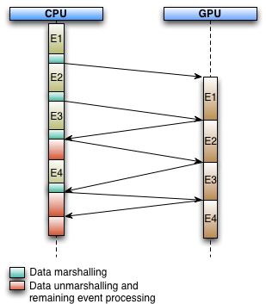
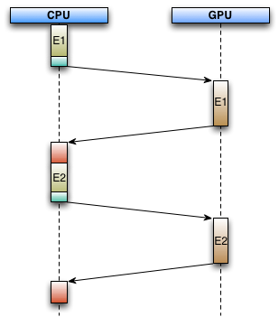
Performance analysis (2)
Ideal execution
Current execution
For 256 variations the CPU is idle
31% of the time…
A single global state
prevents simultaneous CPU & GPU processing

Slide 22

Alternative 1c: parallelize KinFit, 1x CPU-core with MIC accelerator
(i) MIC native
(ii) MIC offload
MIC native:
Whole application runs on Xeon Phi (1 core reserved for OS)
Frameworks, libraries and application compiled for the device
Simple port (Intel claims)
All input data must be manually copied to the device, prior to execution
MIC offload:
Similar to the GPU implementation
Xeon Phi can use all cores
ROOT classes do not work on the device in this configuration
Data transfers between CPU and Xeon Phi for every event…

Slide 23
Alternative 1c: parallelize KinFit, 1x CPU-core with MIC accelerator
(i) MIC native
(ii) MIC offload
MIC native limitations:
ROOT compilation for this architecture released on a patch, but with a bug
Other required libraries not so easy to properly function on the device
Implementation left on hold
MIC offload limitations:
ROOT classes on the device – not viable to have a version compiled for the device and CPU simultaneously
Data transfers between device and CPU for each event are costly
Drivers are still too “young” causing many problems to the preliminary implementation

Slide 24
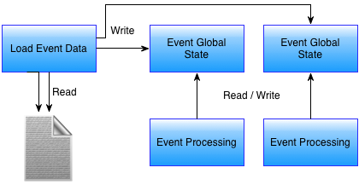
Alternative 2: a global state per event
Sequential
Parallel
...

Slide 25
Comparative performance (shared memory)

Slide 26
Comparative performance (shared memory)

Slide 27
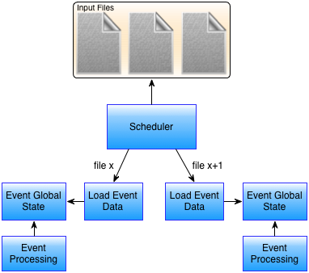
Alternative 3: events from different files
Sequential
Parallel
...

Slide 28
Alternative 3a: events from different files shared memory, no h/w accelerators
Software scheduler
Receives the application and its input parameters
Dynamically distributes the workload (files to process) among the resources of the system
Designed to obtain the best resource usage without user intervention
Configuration (user defined) affect the efficiency for different systems
Future work: exploit the use of micro-benchmarks to evaluate the system performance and automatically set the best configuration

Slide 29
Alternative 3a: events from different files shared memory, no h/w accelerators
Scheduler tested on the c.n. 711
Using the most efficient (not fastest!) shared memory implementation – pointer to shared data implementation with 4, 8 and 16 threads
Scheduler set a combination of applications to use all physical/virtual cores (2 apps with 16 threads, 4 apps with 4 threads, …)
Compared against the fastest version for the same total number of threads – all data replicated implementation

Slide 30
Performance analysis (1)
# of variations

Slide 31
Performance analysis (2)

Slide 32
Efficient processing of ATLAS events analysis in platforms with accelerator devices
University of Minho
Department of Informatics
André Pereira
Prof. Alberto Proença (Advisor)
Prof. António Onofre (Co-Advisor)

